Slide 1

Credit Card Customer Journey
Demo Case
by Rayhan Narawangsa
February 2024

Slide 2
Background and Approaches
Background
Credit Card is one of the biggest revenue getter for banking industries, one common customer acquisition procedure is by- face-to-face marketing. Therefore, we need tools to sharpen targeted location and reduce potential cost.
Base revenue from Credit Card Company comes from spending, we need thorough framework to optimize customer transactions.
Analytics Framework
Acquisition
Maturity Period
Portofolio Management
Month + 0
Month + 3
Month + 9
Month + 12
Acquisition
Portofolio Management
Identify Top Merchant Category and Region: Restaurant and Clothing store, focus region in Jakarta Pusat.
Extract Review from External Data (Google reviews): Acquired data is 2.5k reviews for Resto, and 2.4k for Clothing.
Sentiment Analysis Modeling: Positive, Negative, Neutral.
Top Merchant Scoring: Based on recency and positive sentiment probability.
Determine Potential Merchant: Top 5 in each Merchant Category.
Create dataset to monitor usage for new acquires CC Customer. Base Source: Kaggle bank transactions pulic data.
Create customer grouping to get key customer profiling and recommended merchant for campaign.
Predict customer with revolving balance in the next 3 month after Maturity Period.
Generate leads and revenue simulation.

Slide 3
Acquisition: Data Preprocessing & Model Selection
Data Preprocessing
Vectorization
(TfidfVectorizer)
1
2
3
4
5
Lower Text
Remove Numbers
Remove Punctuation
Stemming
Model Selection
Multi Classification Model (Target : Positive, Neutral, Negative)
Train & Test Split = 0.8 : 0.2
Model Validation
Data Training & Testing | Amount of Data (%)
 | Positive | Neutral | Negative
Data Train | 34.7 | 30.9 | 14.4
Data Test | 8.7 | 7.7 | 3.6
Total Dataset (100%) | 43.4 | 38.6 | 18.0
Data Training & Testing | Random Forest | MLD | Naïve Bayes
Accuracy | 0.82 | 0.77 | 0.53
Precision | 0.81 | 0.77 | 0.68
Recall | 0.82 | 0.77 | 0.53
F-1 Score | 0.82 | 0.77 | 0.53
Cross-Validation | 0.80 | 0.75 | 0.51
Review data distribution from Google:
Data Prediction | Target |  |  | Total
 | Positive | Neutral | Negative
Merchant Restaurant | 1,570 | 795 | 166 | 2,531
Merchant Clothing Store | 1,420 | 816 | 119 | 2,355
Total Data Prediction | 2,990 | 1,611 | 285 | 4,886
Key Highlight
Therefore, for Sentiment Analysis, we are using Random Forest Model, since it has the highest model performance result.

Slide 4


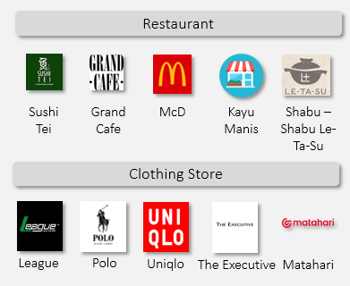
Acquisition: Data Preprocessing & Model Selection
To capture the sentiment trend of each merchant, we use scoring to assign weight based on last review period. The most recent month will have higher weight than previous month
Period | Weight | Probability of Positive Sentiment | Scoring Per Month
Month 0 & - 1 | 45% | Total Positive Sentiment / Total Review In respectively each month’s group | 0.45 * Probability of positive sentiment
Month -2 & -3 | 35% |  | 0.35 * Probability of positive sentiment
Month -4 % -5 | 20% |  | 0.2 * Probability of Positive Sentiment
Total Scoring |  |  | Total Scoring each Month’s Group
Capture & Prioritize merchants who are growing & consistently have positive sentiment.
Illustration
Shabu-Shabu Le-Ta-Su
Location = Grand Indonesia
Total Review = 89
Period | Weight | Probability of Positive Sentiment | Scoring per Year
Month 0 & - 1 | 45% | 49/58 = 0.84 | 0.45 * 0.84 = 0.38
Month -2 & -3 | 35% | 8/14 = 0.57 | 0.35 * 0.57 = 0.2
Month -4 % -5 | 20% | 10/17 = 0.58 | 0.2 * 0.58 = 0.12
Total |  |  | 0.7
Top 5 Merchant
Higher Weight
Period | Total Review | Total positive Sentiment Review
M 0 & - 1 | 58 | 49
M -2 & -3 | 14 | 8
M -4 % -5 | 17 | 0
Total | 89 | 67
From this scoring we were able to see the positive sentiment trend for Shabu-Shabu Le-Ta-Su. We can conclude that this merchant consistently have positive sentiment.

Slide 5
Portofolio Management Customer Clustering
M – 3 to M – 9 (Maturity Period) | M – 10 to M – 11 (Gap Period) | M – 12 (Target Period)
Input: New Acquired CC User | - | Output: Targeted Customer for Specific Campaign
Clustering and RFM (Recency, Frequency, Monetary) modeling done to determine target and matched campaign.
Behavioral Segmentation
Establishes proxy for cars usage drivers
Cluster | Top Merchant | Key Highlights
 | Housing, Travel, Automotive | Aged 30 – 40 yo, higher income and high CC spending.
 | Travel, Automotive, Restaurant | Aged 20 – 30 yo, moderate income and high CC spending.
 | Shopping, Restaurant, E-Commerce | Aged 40 – 50 yo, higher income and lower CC spending.
 | Shopping, E-Commerce, Groceries | Aged 20 – 30 yo, lower income and CC spending
Spend
A
Champion (10%)
A
Spend Preference
Informs incentive design and category expansion plus product design
B
Explorer (24%)
B
C
Revenue Monitoring
Identiy High Value Customers and focuses retention activities
D
C
Balancer (18%)
Conservative (48%)
D
Income

Slide 6

Portofolio Management Predict Revolving Customer
Customers status sizing after 4 Month of Maturity Period:
M – 3 to M – 9 (Maturity Period) | M – 10 to M – 11 (Gap Period) | M – 12 (Target Period) | Tag
CC User | - | Credit Card Closed | 0
CC User | - | No Transaction | 0
CC User | - | No Revolving Balance | 0
CC User | - | Have Revolving Balance | 1
21%
66%
Have Revolving Balance
Base data is CC user in 6 month period, with amount of 12k customers.
Framework is aimed to optimize revenue from customer Credit Card interest.
Target for prediction is customer who Have Revolving Balance (33%), with amount of 2.5k customers.
10%
3%
No Revolving Balance
No Transaction
Close

Slide 7
Predict Revolving Customer - Model Evaluation
Evaluation Result
Used Model: XG Boost
Train & Test Split = 0.8 : 0.2
Parameter | Accuracy | Recall | Presicion | F1 Score | Decile Analysis
Value | 83% | 77% | 73% | 75% | 77% target is captured in top 3 decile.
Gain Chart Analysis: Test Data
Test Result Sizing
Model is able to capture 77% of potential leads in the top 3 Decile.
Base New CC User
5k
Have Revolving Balance
240
Captured in Model Top 3 Decile
184
Actual Monthly Simulation
Base New CC User
Have Revolving Balance
Captured in Model Top 3 Decile
Potential Leads
12k
2.5k
1,925

Slide 8



Revenue Simulation
Remarks | Customer RFM Model |  |  |  | Total
 | Champion | Explorer | Balancer | Concervative
Top Merchant | Housing, Travel, Automotive | Travel, Automotive, Restaurant | Shopping, Restaurant, E-Commerce | Shopping, E-Commerce, Groceries
Number of Leads | 770 | 481 | 385 | 289 | 1,925
Avg. Sales Volume* | 20 Mio | 15 Mio | 10 Mio | 5 Mio | -
Avg. Customer Interest Rate** | 18% | 15% | 10% | 8% | -
Revenue Calculation*** | 2.7 Bio | 1.1 Bio | 385 Mio | 115.6 Mio | 4.4 Bio
*** Avg. Interest Rate x Avg. Sales Volume x Number of Leads
* Average per Customer in related Merchant
** Average per Customer
= Priority
Next Action Plan
Generate Project Documentation and Script Automation
Coordinate with Business Team for Leads Targeting
Provide tracking for Model Result and Revenue

Slide 9
Thank you

Slide 10










Result: Top Merchant – Based on MCC
From our modelling, we recommend CIMB Niaga to tap into the following merchants:
Restaurant
Clothing Store
Merchant Name
Total Scoring
Quality of Service
Quality of Products
Price
Convenient Place
Sushi
Tei
Grand
Cafe
McD
Kayu Manis
Shabu – Shabu Le-Ta-Su
League
Polo
Uniqlo
The Executive
Matahari
Key Highlight: Across Restaurant and Clothing Store MCC, the main driver is Quality of Products.
For Restaurant, merchant with 1 driver have tendency to have inconsistent positive sentiment value
Notes:
Tambah Framework Gambaran besar

Slide 11
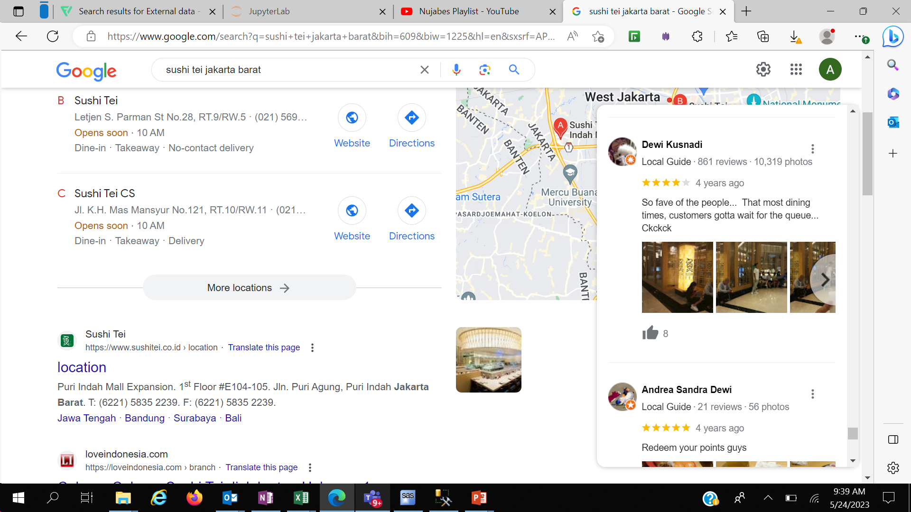
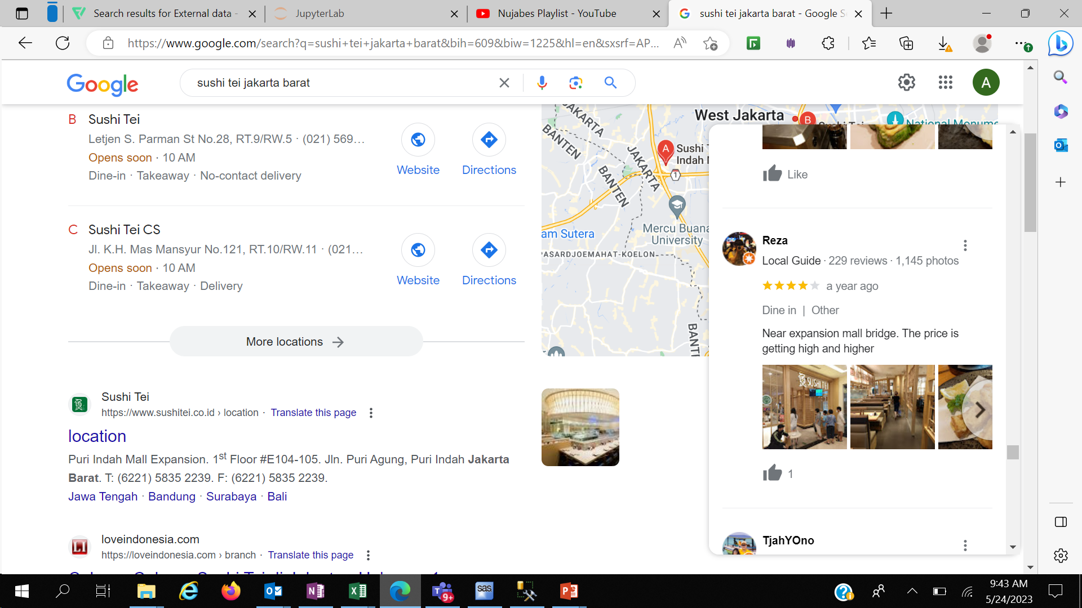












Overview – Background, Proposed Solution & Potential Benefits
Compare rating sama scoring
Background
Merchant Code Category (MCC) Analysis provides an overview of Customer CC Spending Behavior
Can we leverage External Data to better identify which merchant to approach?
*Give 4 out of 5 Stars but negative review
Targeted campaigns & Identify merchants for partnership
However, CIMB Niaga only use Internal data for Analysis
However, scoring from external data might not be reliable
Proposed Solution
1
Sentiment Analysis
2
Scoring Sentiment
3
Category of Quality Drivers Prediction
predict potential merchants that will have positive sentiments in the future
Comprehensive understanding the consistency of the sentiment each merchant
Comprehensive predict of categorize that drives the sentiments of each merchant.
1
Enhance CIMB Niaga’s ability to identify potential merchants
2
Increase Profitability through credit-card and merchant partnership campaigns
Objective
Potential Benefit
1
Revenue Uplift from CC Transaction
2
NTB Acquisition
3
Reducing Campaign Cost as a result of better targeting
Notes:
Tambah Framework Gambaran besar

Slide 12


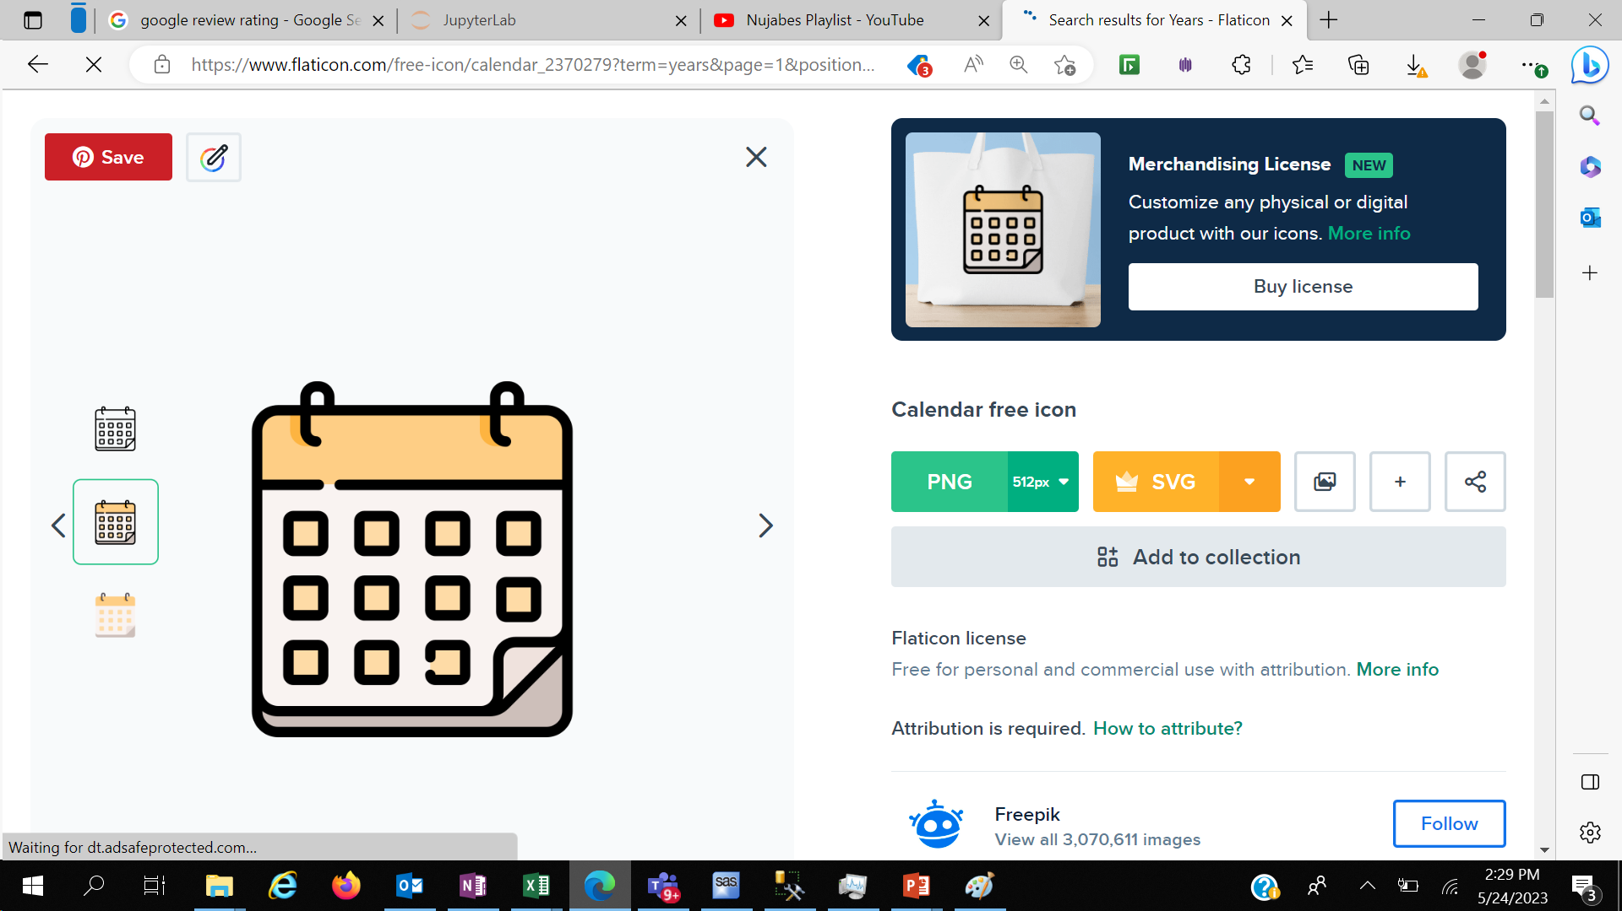



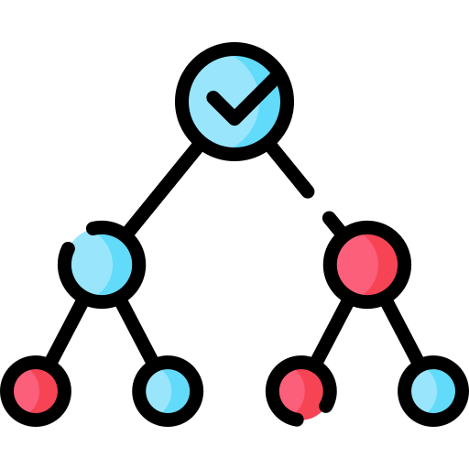

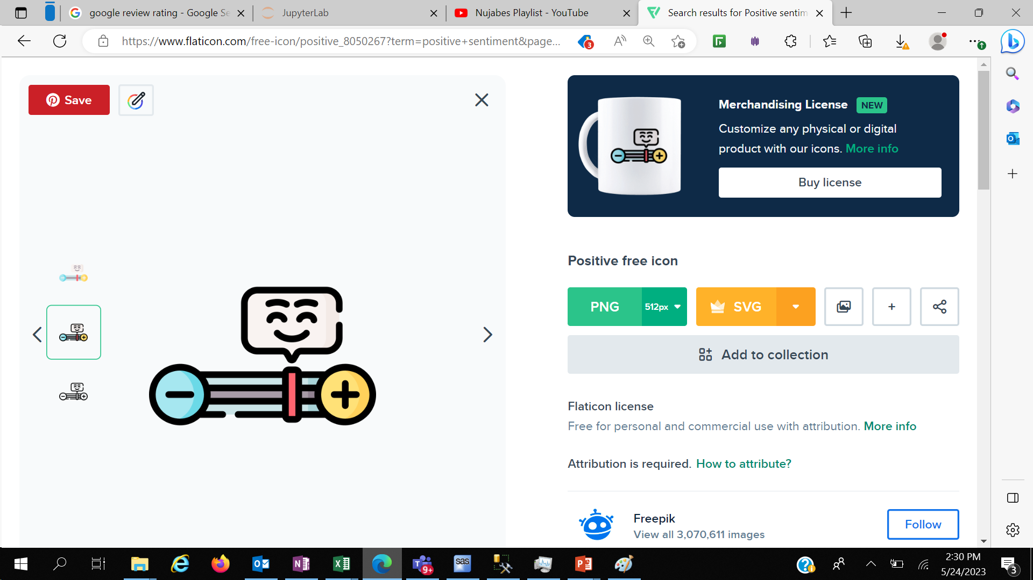
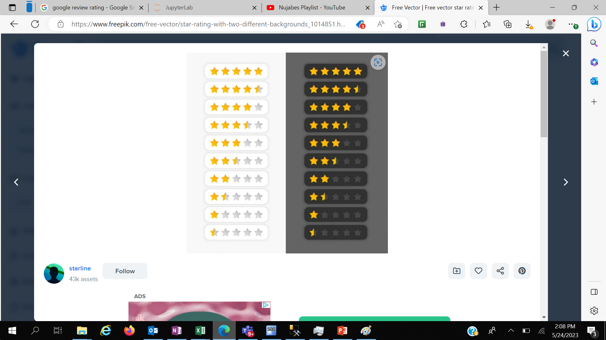


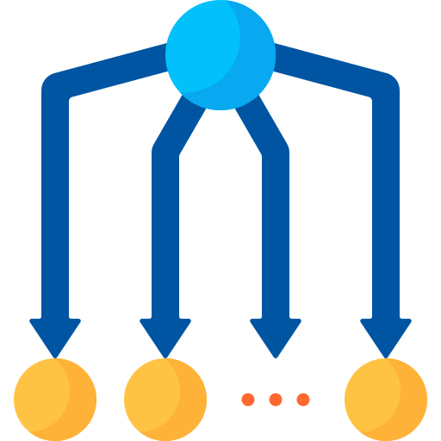
1
Identify Top MCC
& Region
2
Extract Data from External Data
3
Sentiment Analysis Modelling
Create Scoring to Capture Trend Sentiment
Categorize what drives the sentiment
Identify Potential Merchants
4
5
6
MCC Category:
Initial Data:
Google Reviews
Scoring Criteria:
Category:
Tested 4 Models:
Restaurant
Years Passed
Quality of Service
Approach
Clothing Store
Random Forest
Decision Tree
Probability Positive Sentiment
Price
Filter by Rating >3
MLP
Convenient Place
Region:
Jakarta Pusat
Naïve Bayes
Quality of Products
Extracted Data from Google Reviews
4.9 K
Data Overview
| 2.5 K
| 2.4 K
Restaurant
Clothing Store
Notes:
Tambah Framework Gambaran besar

